Slide 1
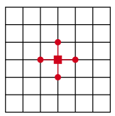
Project C: Morteza Namvar Fall 2021
Poison’s equation
Numerical solution

Slide 2
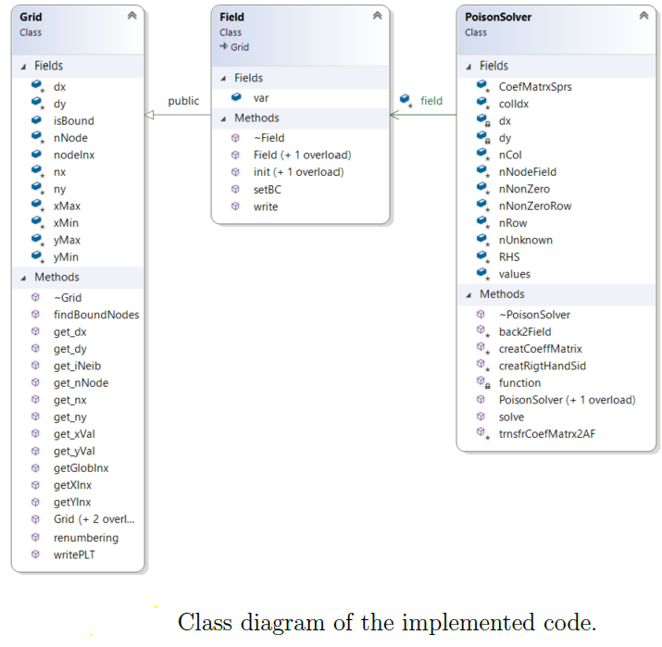
Project C: Morteza Namvar Fall 2021
Poison’s equation

Slide 3
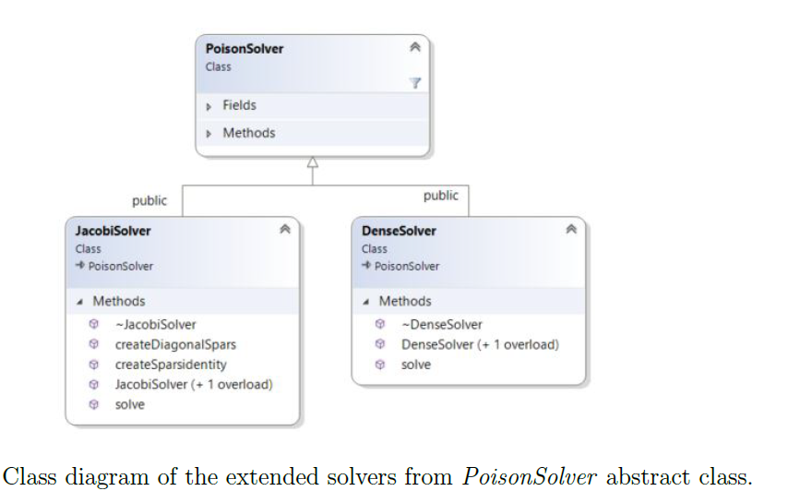
Project C: Morteza Namvar Fall 2021
Poison’s equation

Slide 4
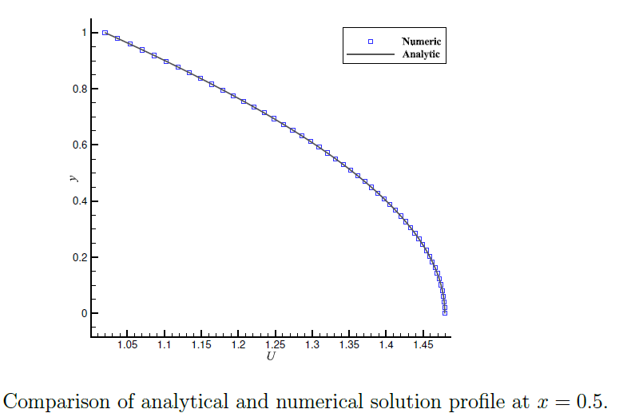
Project C: Morteza Namvar Fall 2021
Poison’s equation

Slide 5
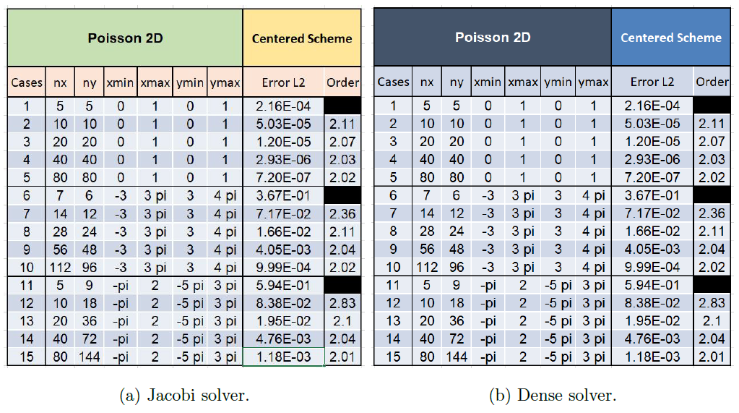
Project C: Morteza Namvar Fall 2021
Poison’s equation

Slide 6
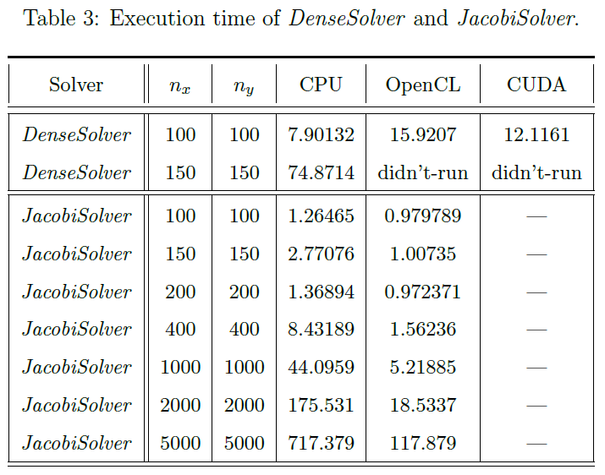
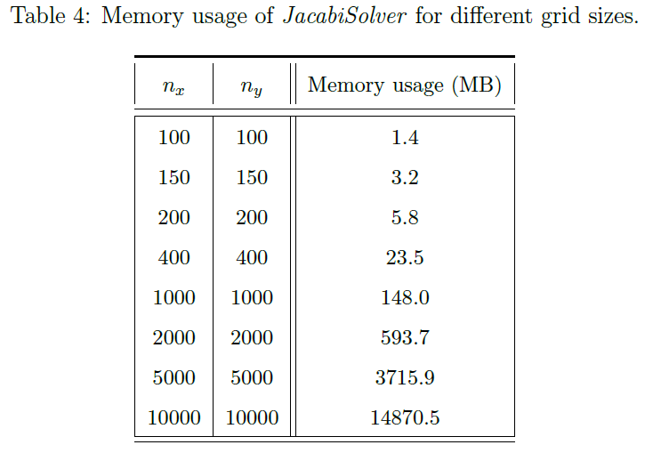
Project C: Morteza Namvar Fall 2021
Poison’s equation

